Slide 1
TEAM 4
Julian, Ruomu, Shaun, Riwu

Slide 2
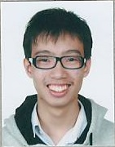
Julian

Slide 3
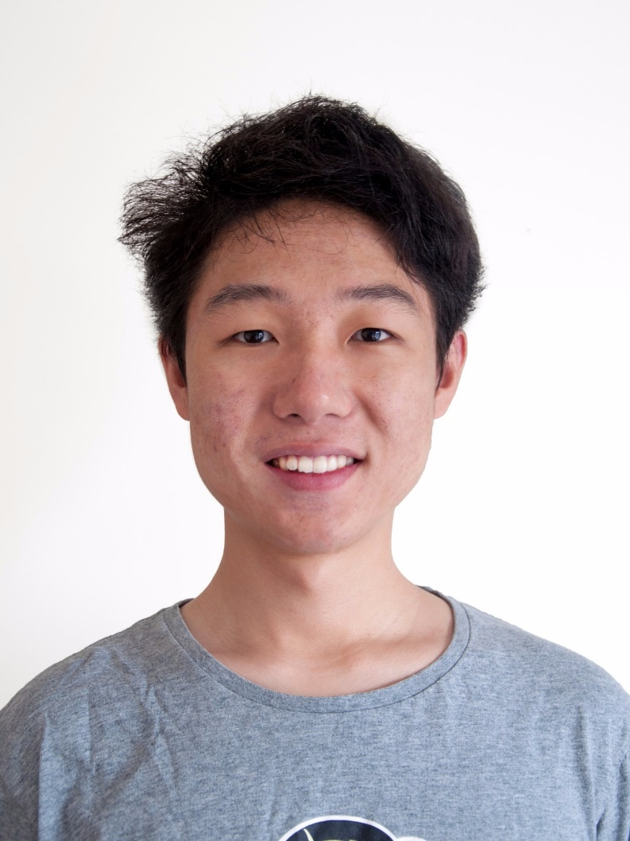
Ruomu

Slide 4
<Insert Shaun’s Photo>

Slide 5
<Insert Riwu’s Photo>

Slide 6
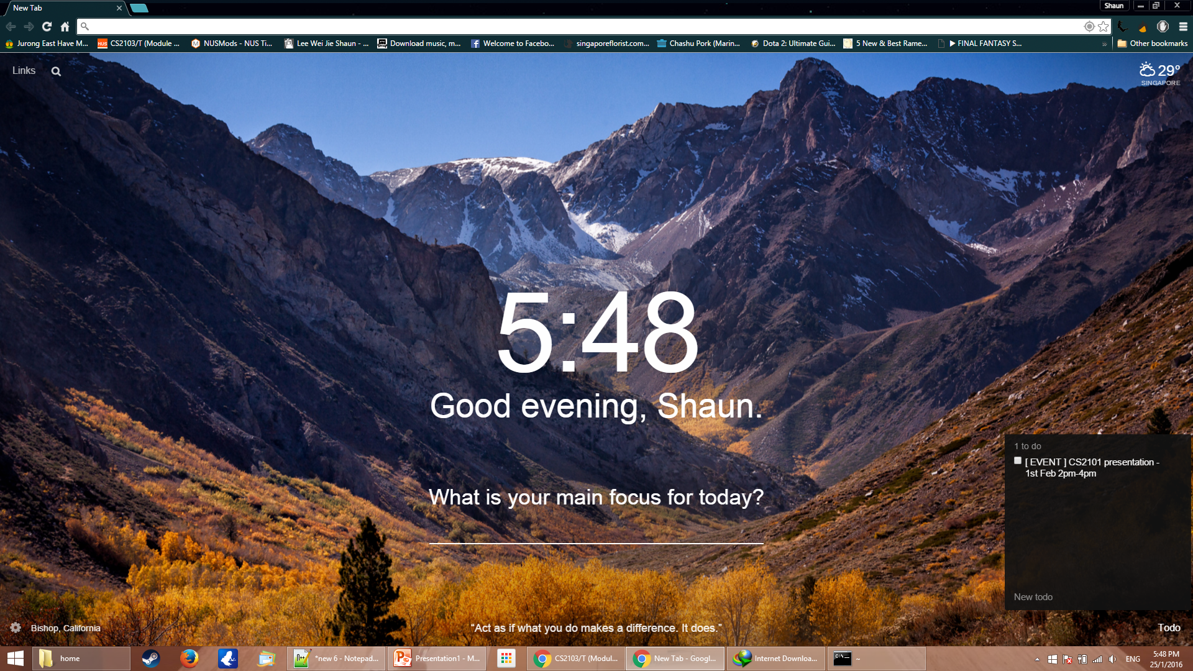
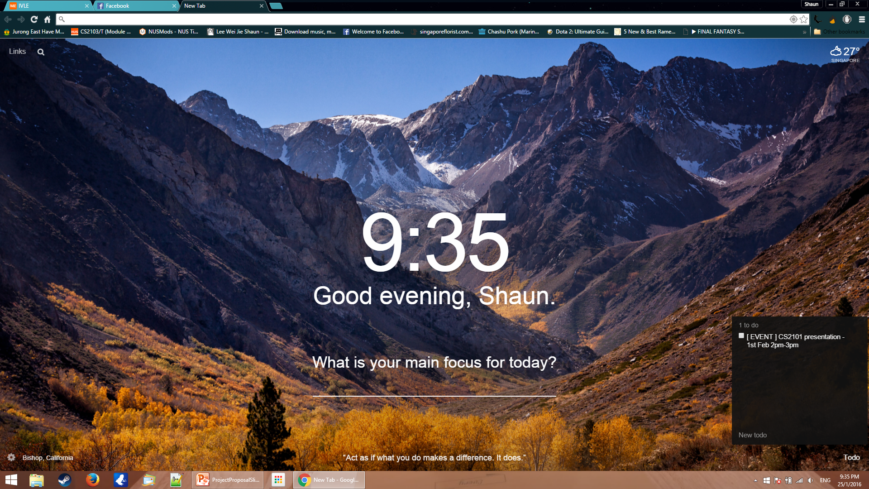
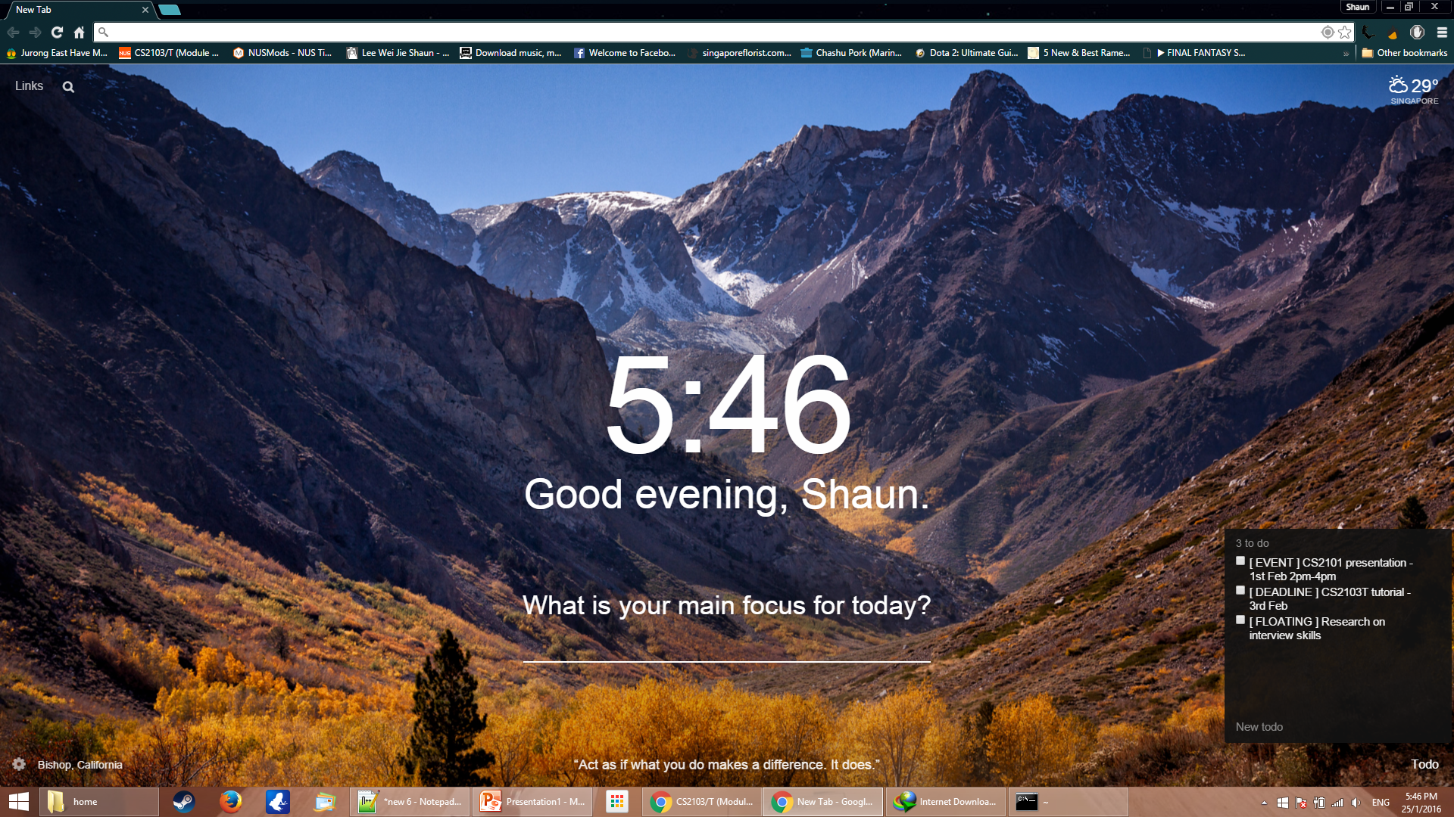
Basic Functionalities
Types of Tasks
Events (time period)
Deadlines
Floating Tasks (no specific)
CRUD
Create
Retrieve
Update
Delete

Slide 7
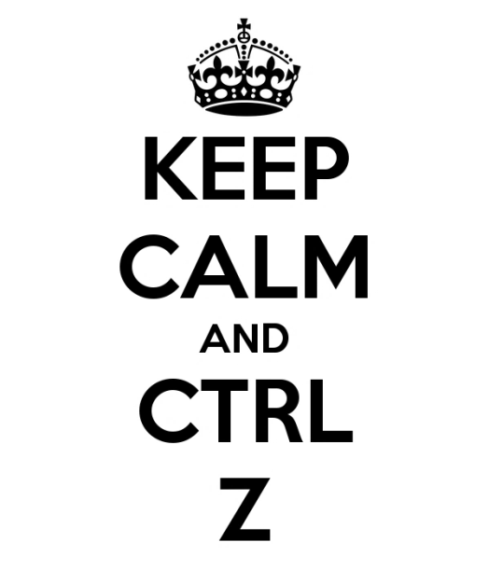
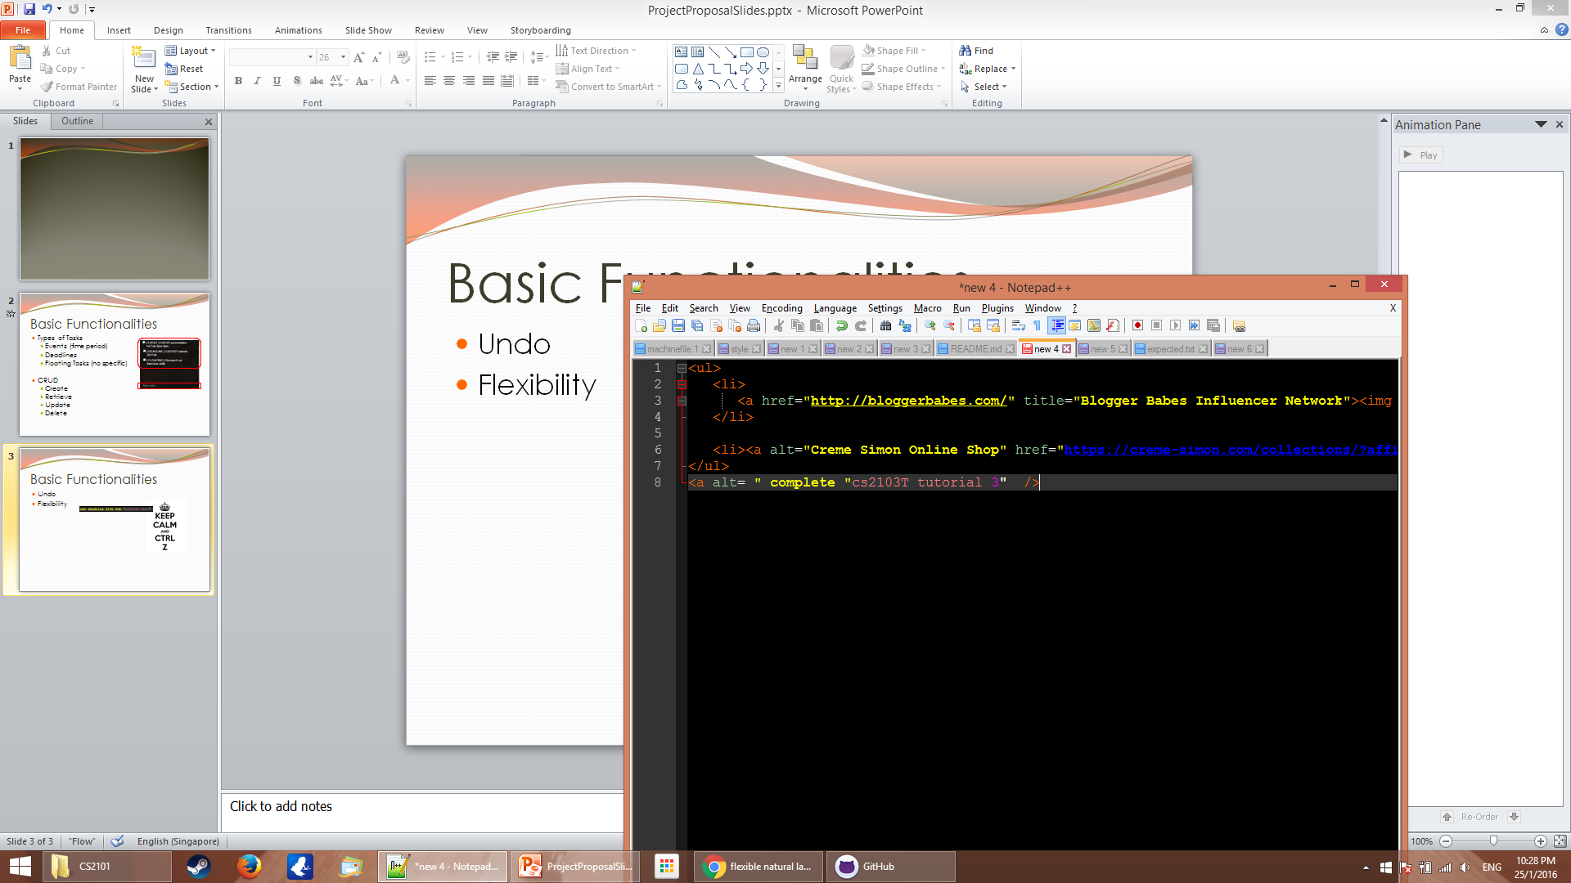
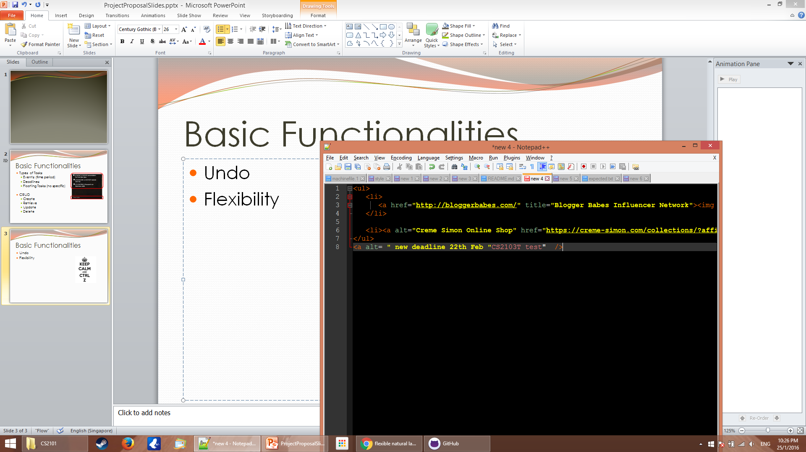
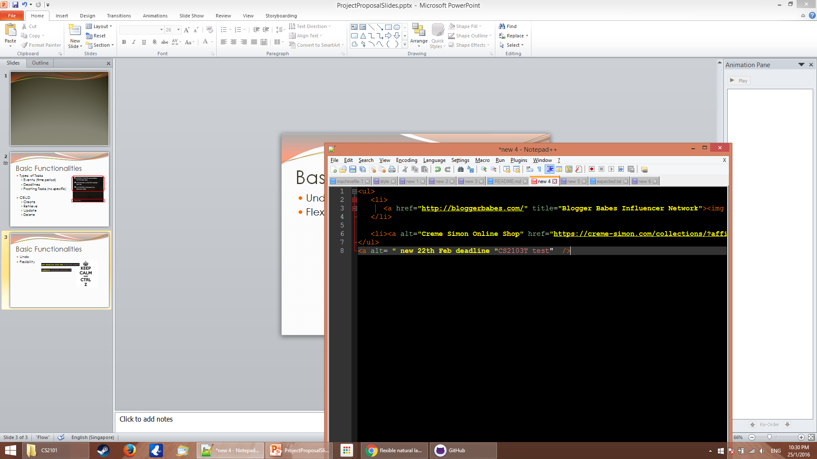


Basic Functionalities
Undo
Flexibility
Accessibility

Slide 8
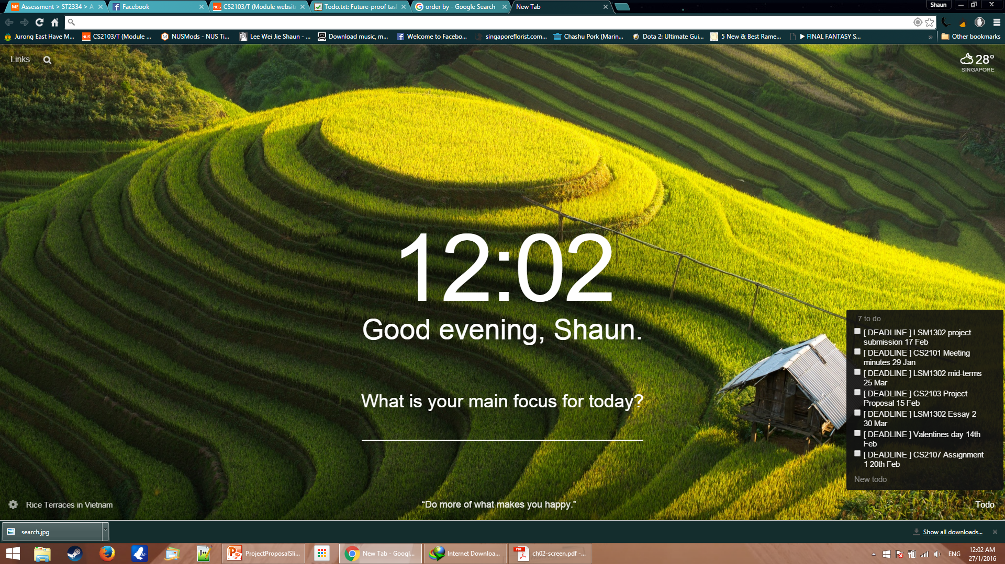

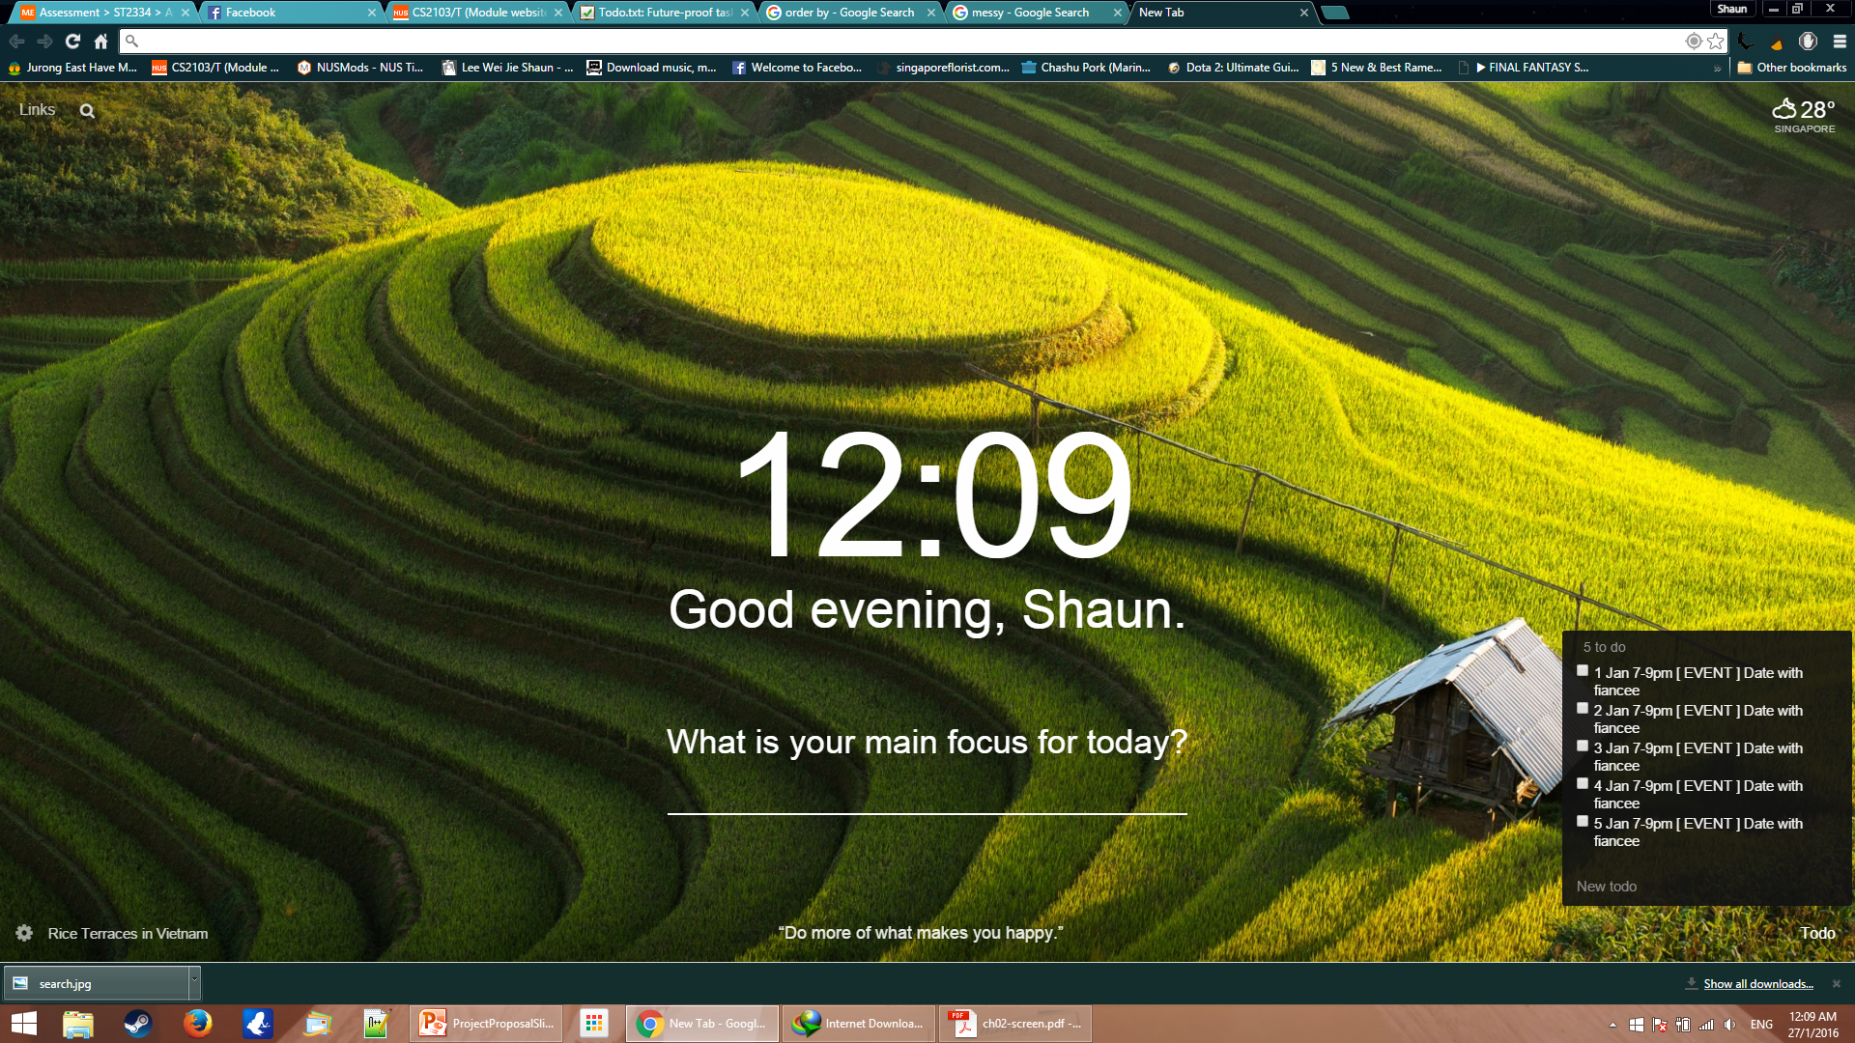
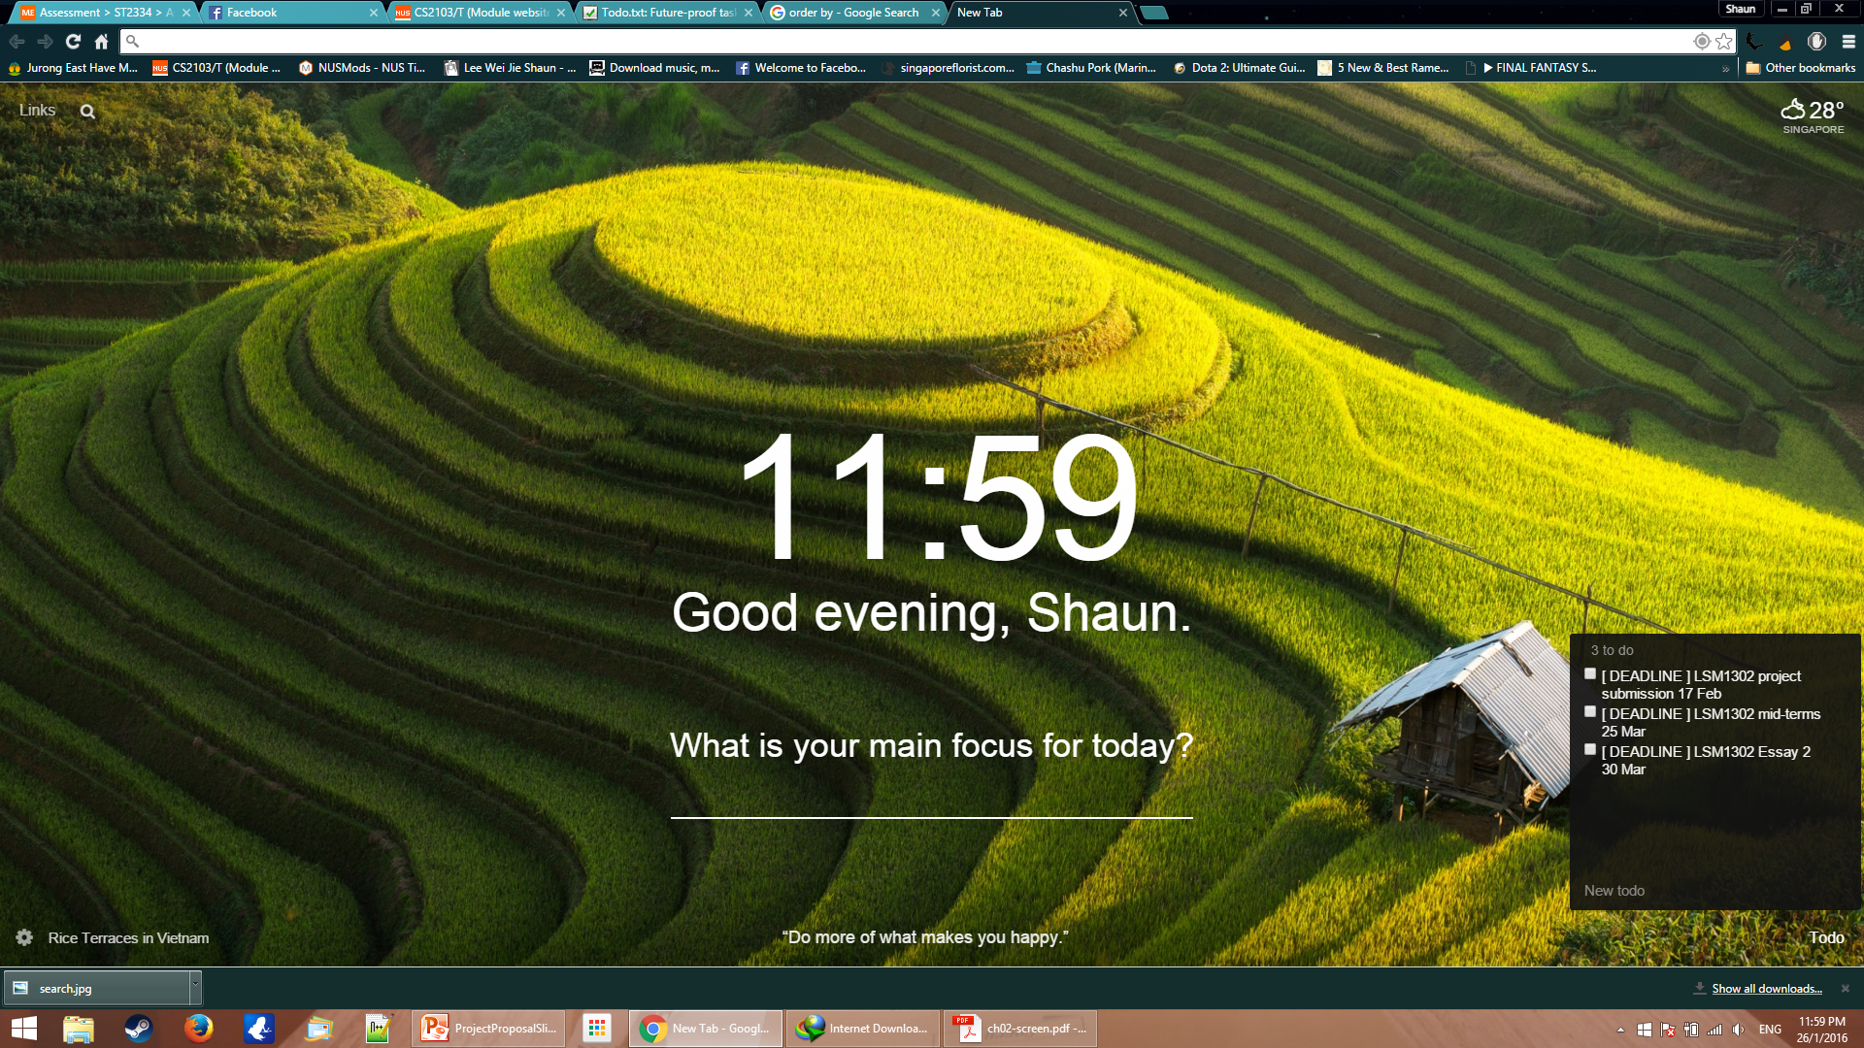
Basic Functionalities
Searching
Sorting
LSM1302

Slide 9
Extra Functionalities(basic)
Recurring tasks
add CS2103T meeting -rw 01256 -t 5pm
Weekly Recurring
Recurring period | Command
Every x days | -rd 4
Weekly (Sun-Sat: 0-6) | -rw 035
Monthly | -rm 21
Yearly | -ry 27.03

Slide 10
Extra Functionalities(basic)
Hot-key call out
Ctrl + Alt + Space

Slide 11
Extra Functionalities(basic)
Short-cut for keywords
add CS2103T meeting -t 15:00 -d 10.02.2016
All alias starts with underscore
add _3t _m –t 3pm –d 10

